Slide 1

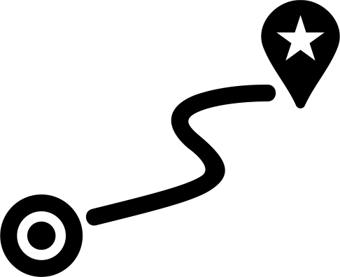

1 mi

Slide 2












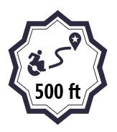
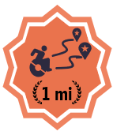
500 ft
0.25 mi
0.5 mi
1 mi
5 mi
0.25 mi
0.5 mi
500 ft
500 ft
500 ft
500 ft
500 ft
500 ft
50

Slide 3












500 ft
0.25 mi
0.5 mi
1 mi
5 mi
500 ft
500 ft
500 ft
500 ft
500 ft
500 ft
500 ft

Slide 4


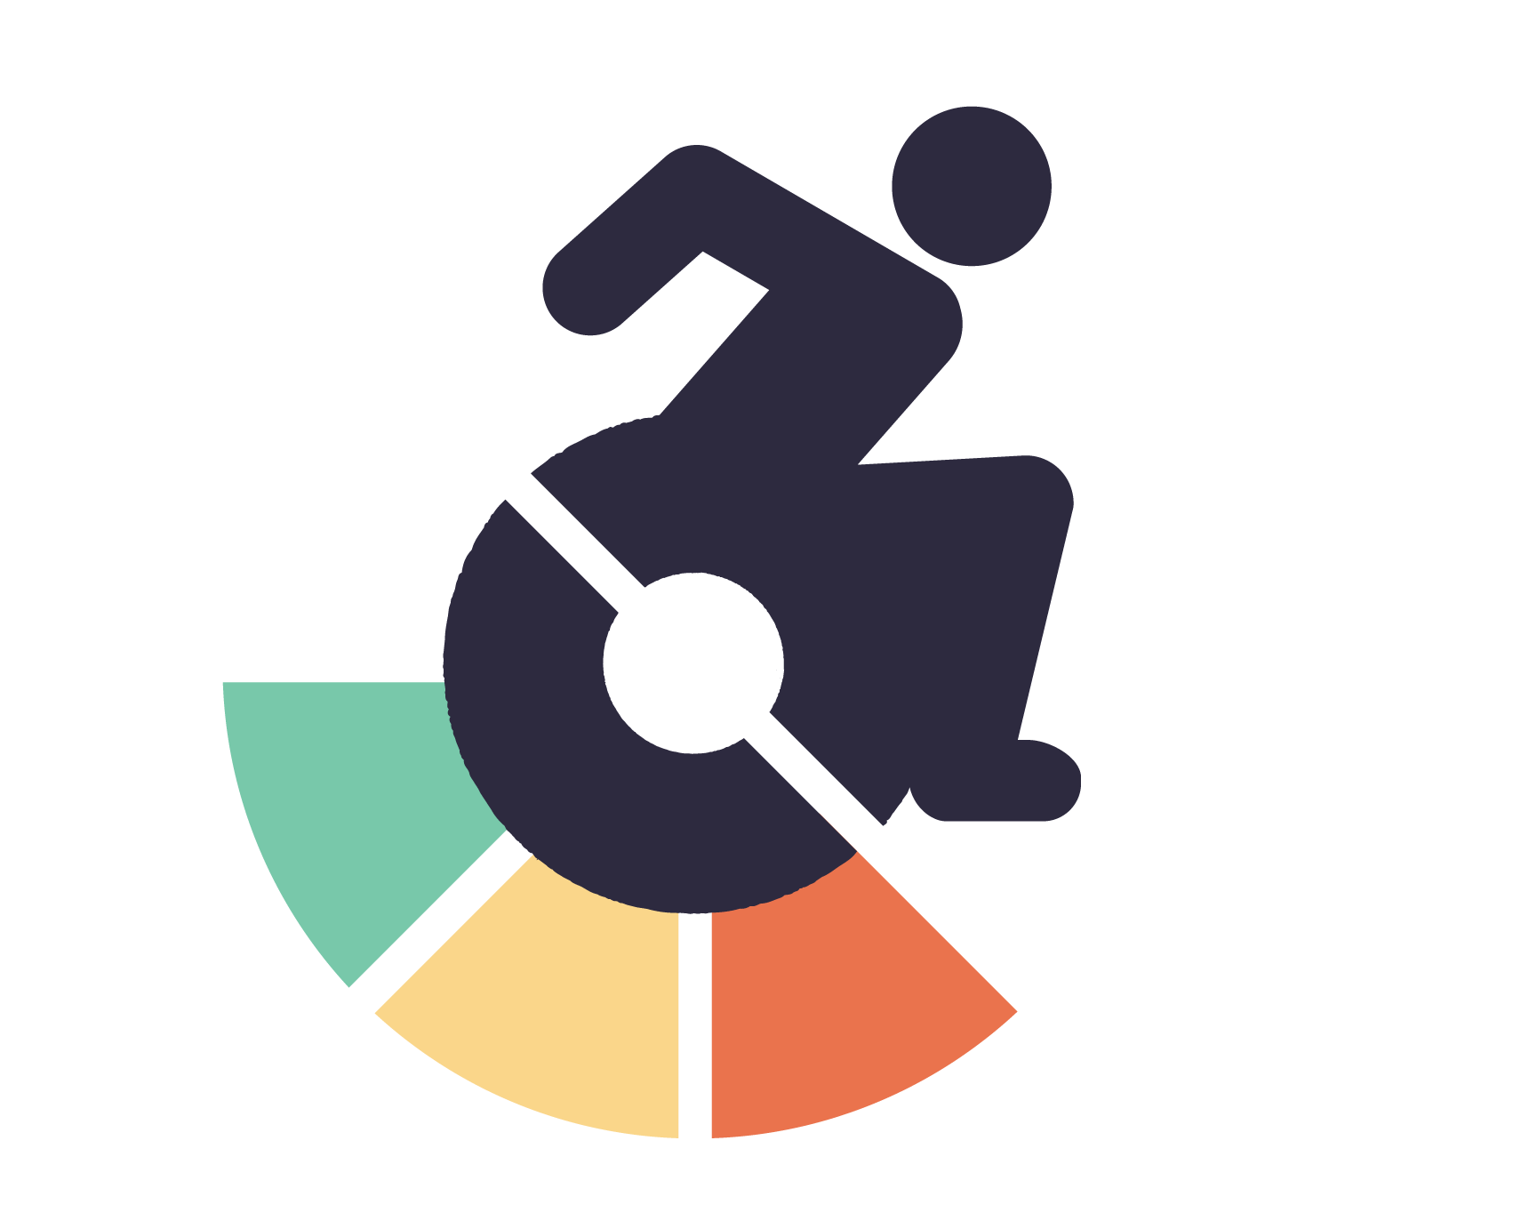
100
500
1k
5k

Slide 5

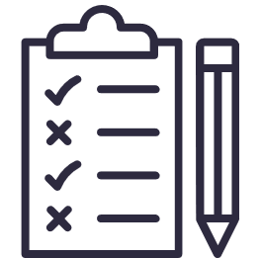
100
250
500
1k
5k
100
250
500
1k
5k
100
250
500
1k
5k
100
250
500
1k
5k

Slide 6



100
250
500
1k
5k
50
250
500
1k
5k
250

Slide 7



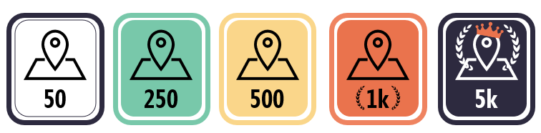
100
250
500
1k
5k
50
250
500
1k
5k
50
250
500
1k
5k
250

Slide 8
50
250
500
1k
5k

Slide 9





10
100
10
10
5
10
20
5
20
20
20
5
10
20
50
100

Slide 10


5
10
20
50
100
100

Slide 11
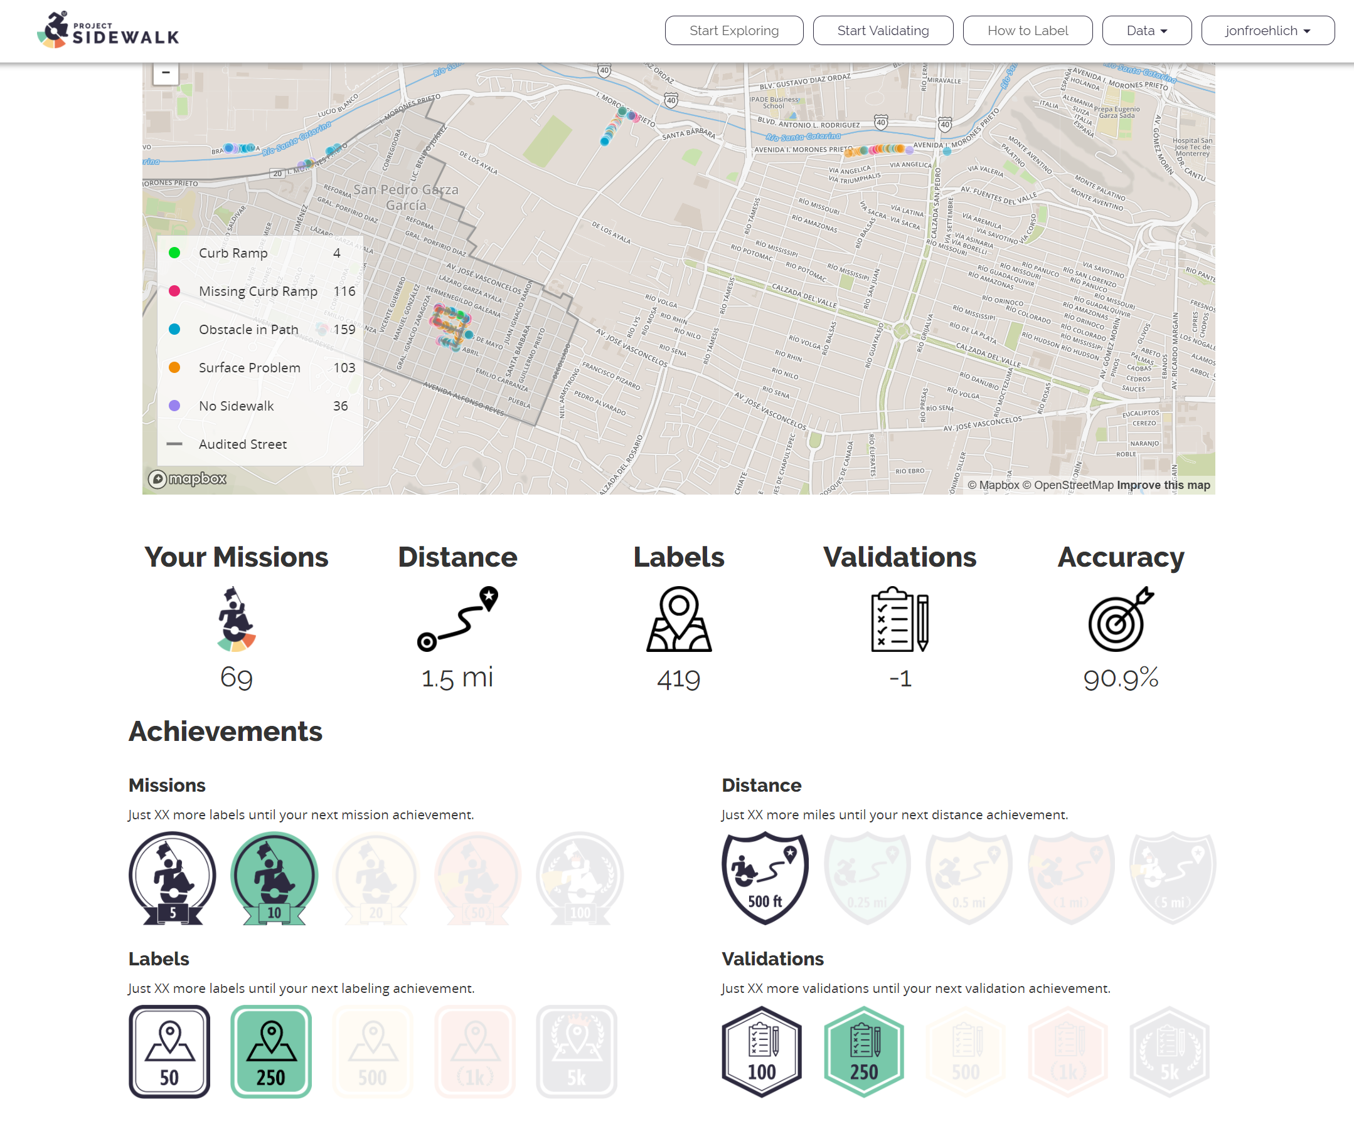

Slide 12

Badges for:
Most accurate
Distance levels (0.5 mi, 1 mi, 5 mi, 10 mi+)
Num Labels (100, 500, 1k, 10k, 50k, 100k)
Num missions
Num validations

Slide 13
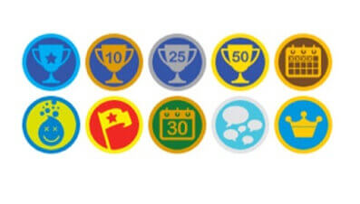



Slide 14
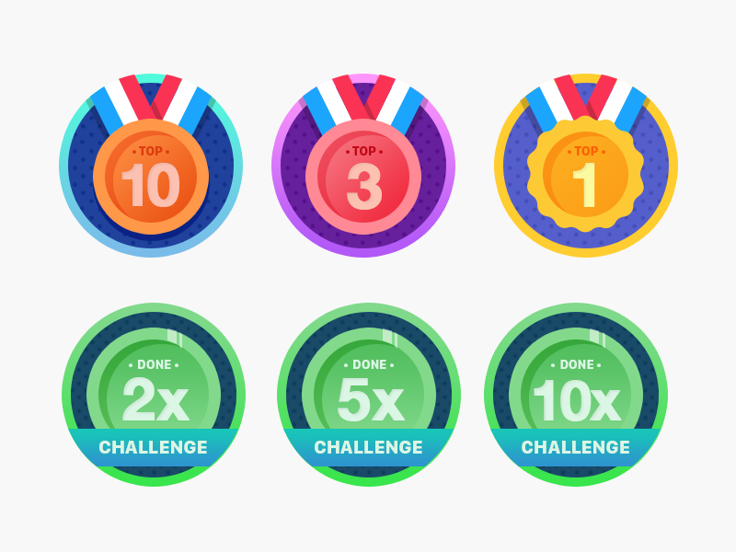

Slide 15

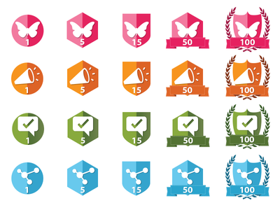


Notes:
https://thenounproject.com/search/?q=wreath&i=203146

Slide 16


Slide 17
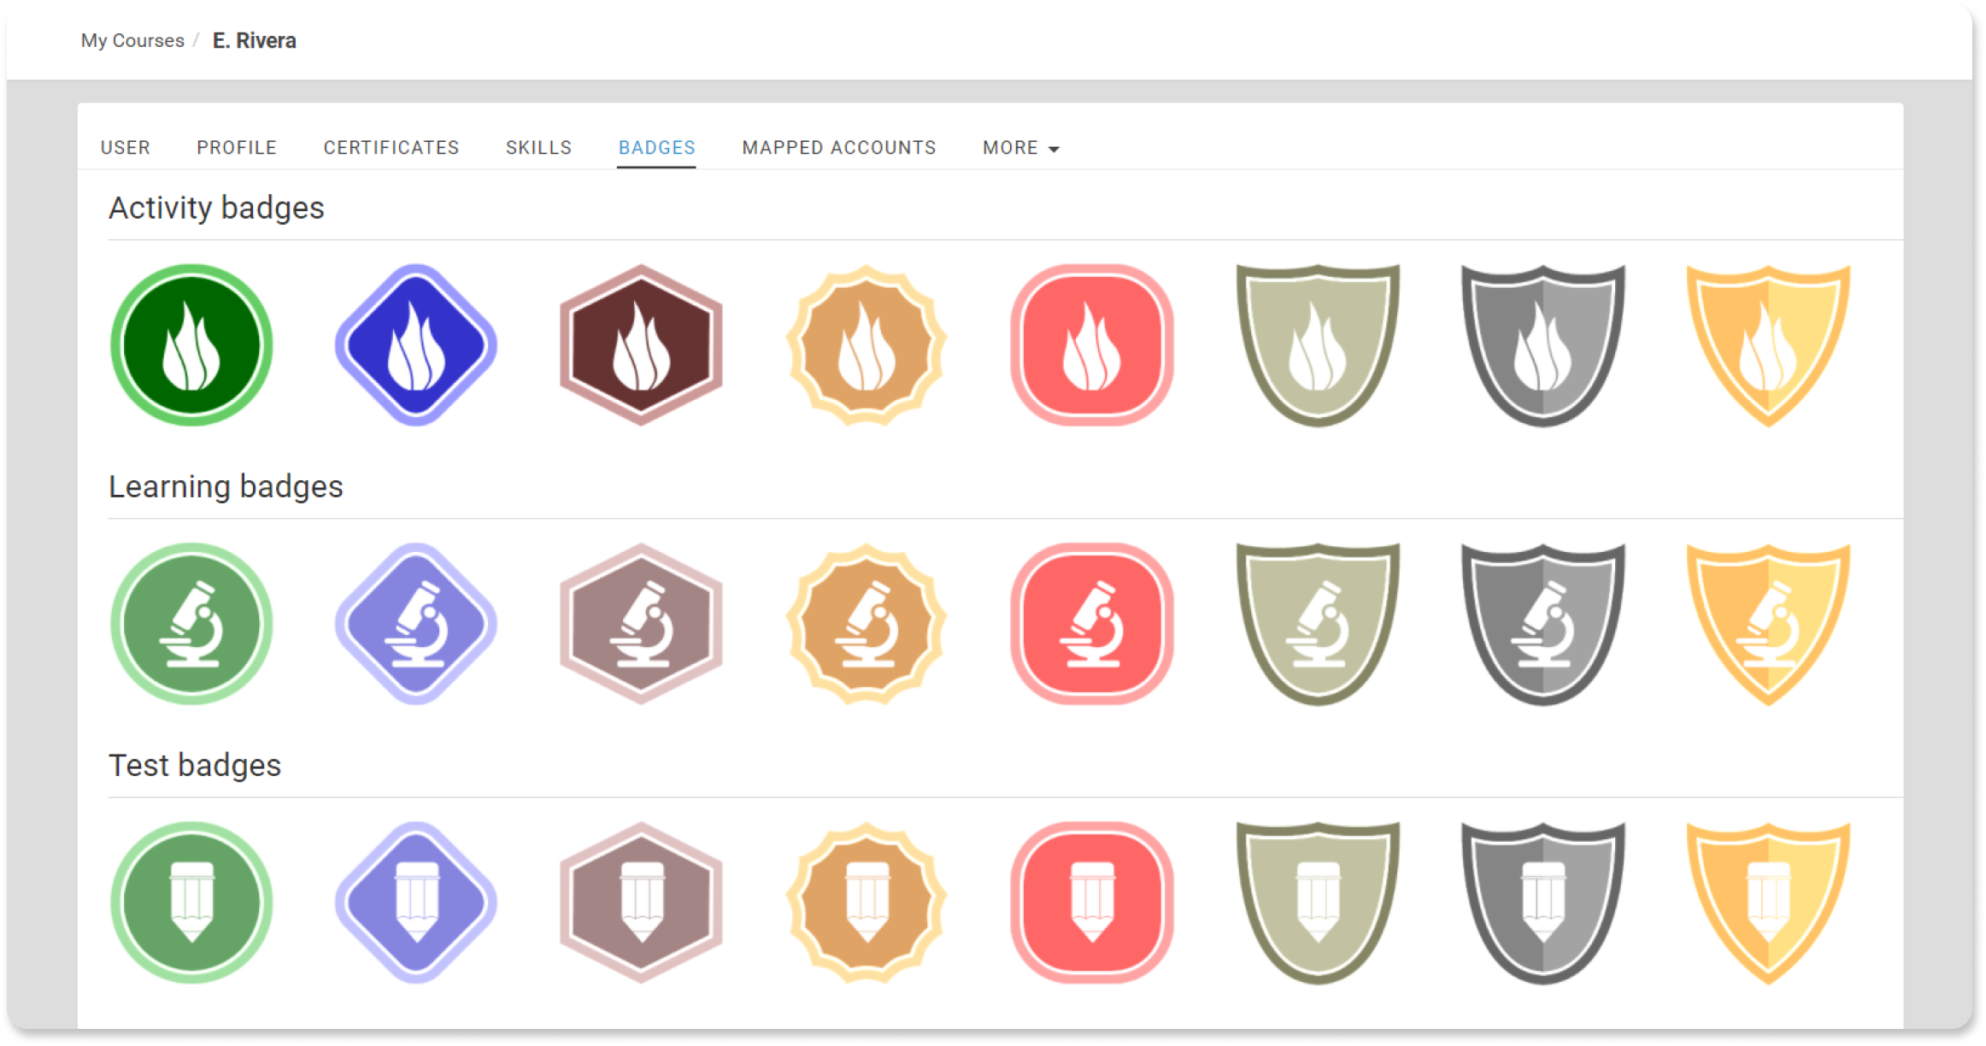

Slide 18









1st
1st
99th
4th
3rd
2nd
1st
5
10
20
50
100
8th

Slide 19
1st
1st
99th
4th
3rd
2nd
1st
5th
5
10
20
50
100
8th

Slide 20
TODO: try different types of trophies for 1st, 2nd, 3rd, 4th-10th?
On mission sidebar, show ranking overall as well as for current neighborhood

Slide 21
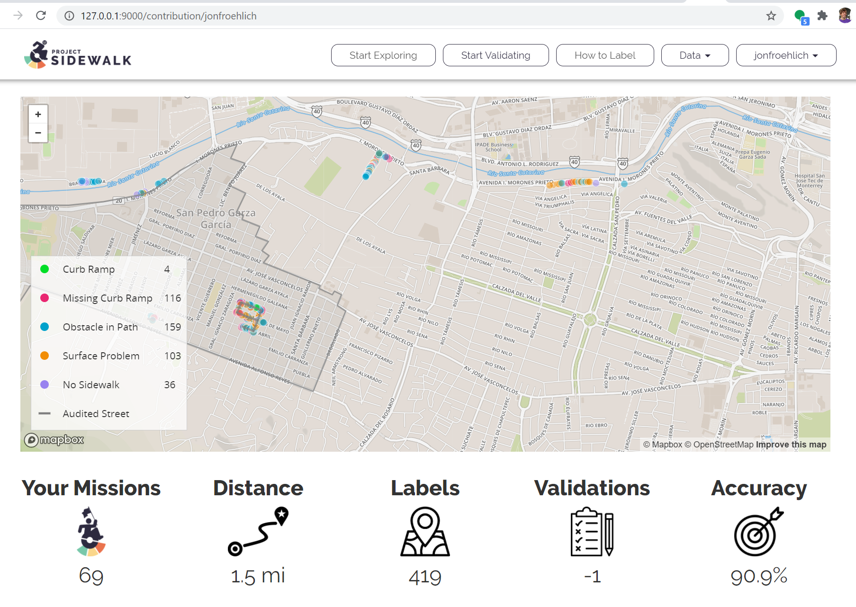


Achievements

Slide 22

1st
Achievements
Missions
Validations
Just 3 more missions until your next achievement!
223 more validations until your next achievement!

Slide 23

Missions
Distance
Distance
1st
3rd
3rd
Rank: 1st
Rank: 3rd
0.2 more miles to move up a position
Rank: 3rd
0.2 more miles to move up a position

Slide 24
Missions
Distance
Labels
Speed Trophy?
Can only be earned if accuracy > 80%
1st
3rd
3rd
Rank: 1st
Rank: 3rd
0.2 more miles to move up a position
Rank: 10+
44 more labels to move up a position

